Slide 1

The Work of the
Blindness Prevention
Rotary Action Group

Slide 2
Eerste River Hospital
Cape Town, South Africa
Sponsor
RC of Constantia (Cape Town, SA)
The Eerste River Hospital is located in an underprivileged area of Cape Town, South Africa. In 2003 the RC of Constantia helped to establish a viable eye clinic in the hospital. The first year only 52 patients received treatment for cataracts. The program has continued to grow over the years with additional diagnostic equipment being added and now they are treating 150+ patients each month.
Notes:
The Eerste River Hospital is located in an underprivileged area of Cape Town, South Africa. In 2003 the RC of Constantia helped to establish a viable eye clinic in the hospital. The first year only 52 patients received treatment for cataracts. The program has continued to grow over the years with additional diagnostic equipment being added and this year they treated 160 patients during a single month alone.

Slide 3
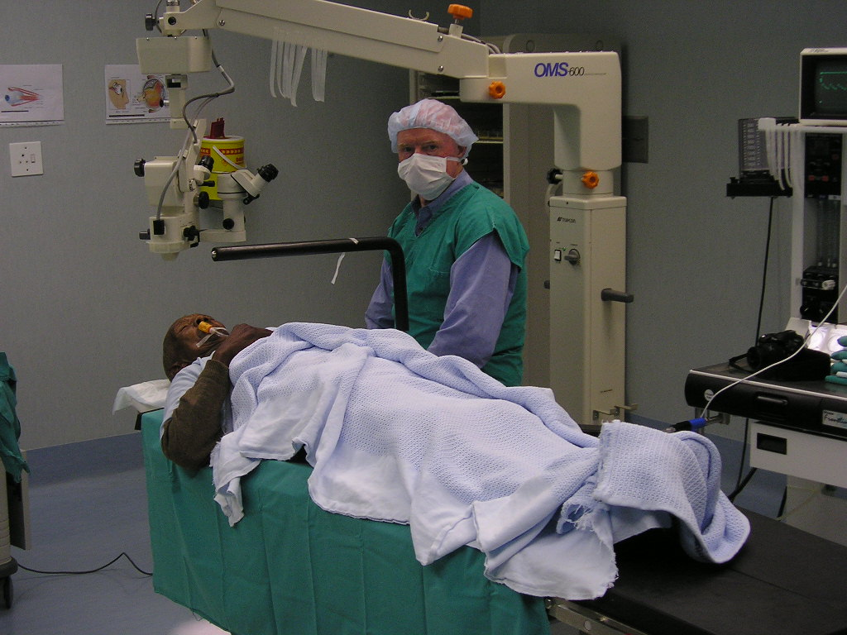
Here you see a cataract patient being prepared for surgery by a Rotary volunteer who is an ophthalmic surgeon. Note the specialized equipment that is suspended from the overhead arm. This was provided with the help of a Rotary Foundation Matching Grant.
Notes:
Here we see a cataract patient being prepared for surgery by a Rotary volunteer. Note the specialized equipment that is suspended from the overhead arm. This was provided with the help of a Rotary Foundation Matching Grant.

Slide 4
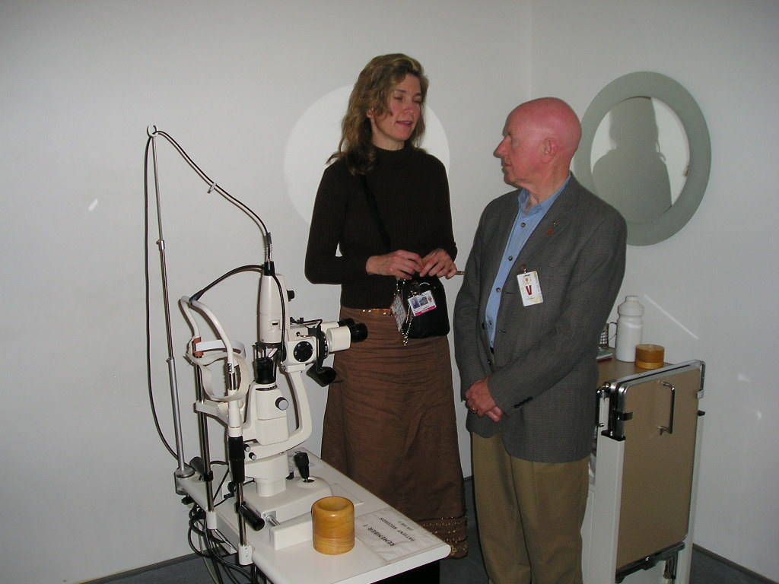
An important new addition to the hospital’s equipment is an Aragon Laser supplied with the help of a Rotary Foundation grant. Diabetes is a major problem among the poor Cape Town population and this new equipment now enables the hospital to offer retinal treatment for diabetic patients.
Notes:
A recent addition to the hospital’s equipment is an Aragon Laser supplied with the help of a Rotary Foundation grant. Diabetes is a major problem among the poor Cape Town population and this new equipment now enables the hospital to offer retinal treatment for diabetic patients.

Slide 5
Zaheerabad, India
RC of Magnolia, Arkansas (USA)
And
RC of Zaheerabad, India
This project, sponsored by the RC of Magnolia, Arkansas (USA) and the RC of Zaheerabad, India, also received DDF funding from Districts 6170 and 6060 in Missouri as well as the Blindness Prevention Donor Advised Fund. The project included 500 cataract surgeries, 1,000 refractive exams with 1000 pairs of prescription glasses and 1000 pair of safety glasses for agricultural workers.
Notes:
This project, sponsored by the RC of Magnolia, Arkansas (USA) and the RC of Zaheerabad, India, also received DDF funding from Districts 6170 and 6060 in Missouri as well as the Blindness Prevention Donor Advised Fund. The project provided 500 cataract surgeries. 1,000 refractive exams with 1000 pairs of prescription glasses and 1000 pair of safety glasses for agricultural workers.

Slide 6
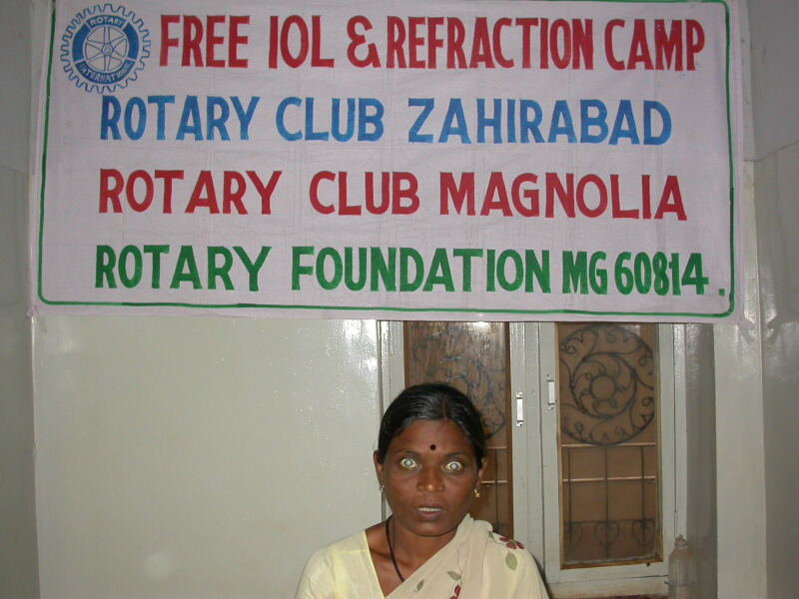
This mother, in her early 40’s, was blind from cataracts in both eyes. She has an 11 year old son who had to leave school in order to earn a few rupees since his mother could not work.
Notes:
This mother, in her early 40’s, was blind from cataracts in both eyes. She has an 11 year old son who had to leave school in order to earn a few rupees since his mother could not work.

Slide 7
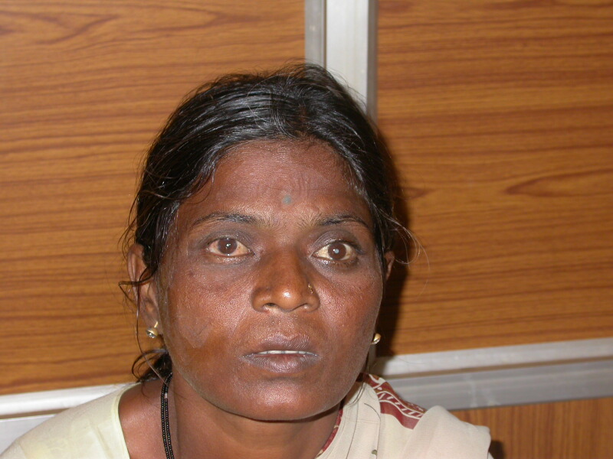
She had one cataract removed as part of the Rotary project and her son was able to return to school. Three months later she had her second surgery and is now completely cataract free. As a result, she is now able to once again work outside the home.
Notes:
She had one cataract removed as part of the Rotary project and her son is now back in school. In 3-4 months, she will have the other cataract removed.

Slide 8
Matching Grant #62332
RC of Dharmavaram Midtown, India
And
Rotary Club of South Gateway, IN
Matching Grant 62332 funded 1500 cataract surgeries, 2000 refractive exams and prescription glasses and 1000 pair of safety glasses for agricultural workers. It was sponsored by the RC of Dharmavaram Midtown in India and the RC of South Gateway in South Bend, Indiana. Additional funding came from Districts 6060 and 6110 as well as the Blindness Prevention Donor Advised Fund.
Notes:
Matching Grant 62332 funded 1500 cataract surgeries, 2000 refractive exams and prescription glasses and 1000 pair of safety glasses for agricultural workers. It was sponsored by the RC of Dharmavaram Midtown in India and the RC of South Gateway in South Bend, Indiana. Additional funding came from Districts 6060 and 6110 as well as the Blindness Prevention Donor Advised Fund.

Slide 9
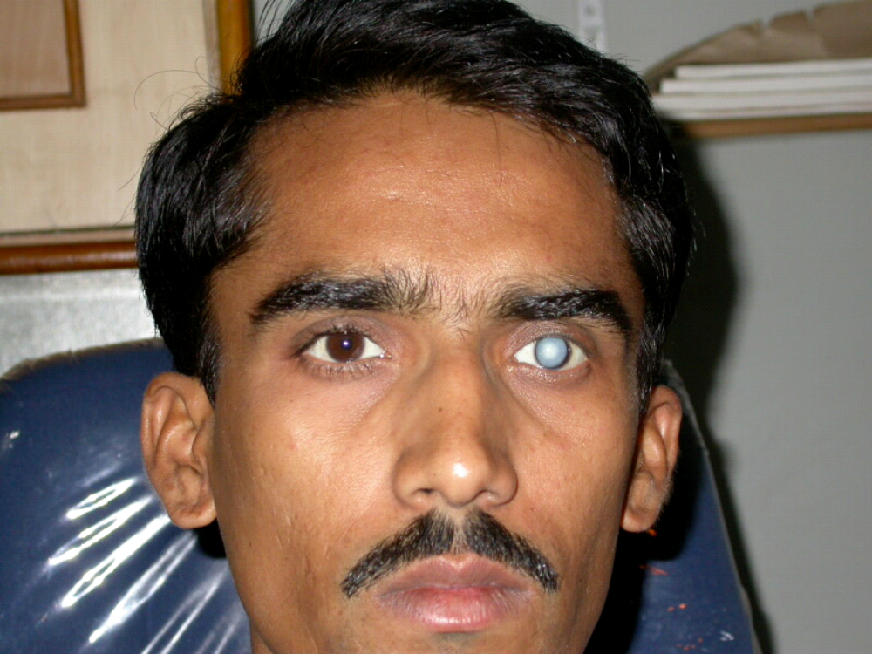
This young fellow is a college student studying for his Master of Arts degree. Not only were his studies at risk, but there is great social stigma attached to having a cataract that is so visible.
Notes:
This young fellow is a college student studying for his Master of Arts degree. Not only were his studies at risk, but there is great social stigma attached to having a cataract that is so visible.

Slide 10
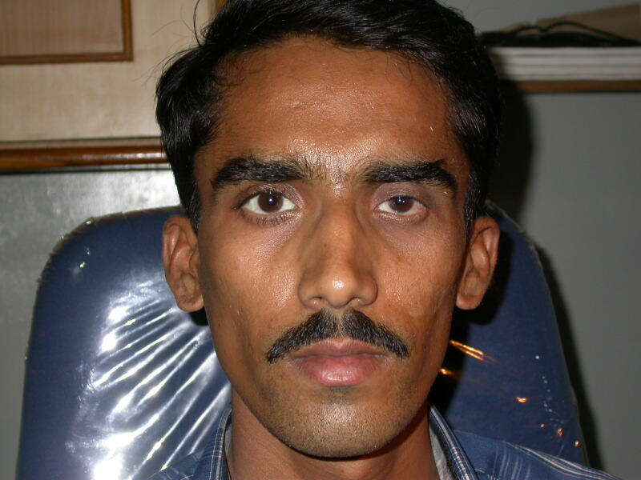
He came through the surgery with great results and is now back at his studies in earnest.
Notes:
He came through the surgery with great results and is now back at his studies in earnest.

Slide 11
Usha Kiran Eye Hospital
Karnataka, India
RC of Mysore West, India
Dr. Uma Ravishankar Kowshik Venkatasubbiah of the RC of Mysore West, is the Medical Director of the Usha Kiran Eye Hospital in Karnataka, India. Through her efforts, the RC of Mysore West, (assisted by a TRF Global Grant) has been responsible for sponsoring numerous corrective eye surgeries.
Notes:
Dr. Uma Ravishankar Kowshik Venkatasubbiah of the RC of Mysore West, is the Medical Director of the Usha Kiran Eye Hospital in Karnataka, India. Through her efforts the RC of Mysore West, assisted by a TRF Matching Grant has been responsible for sponsoring numerous corrective eye surgeries. Here are just a few of the hundreds of success stories.

Slide 12
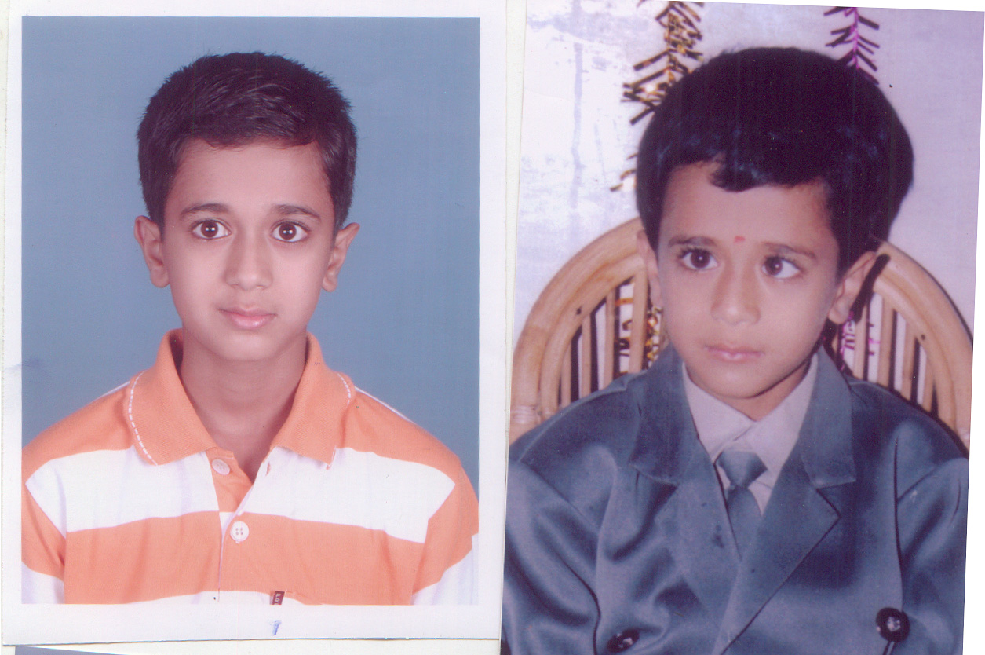
This young boy received surgery for crossed eyes. As you can see, the surgery was very successful.

Slide 13
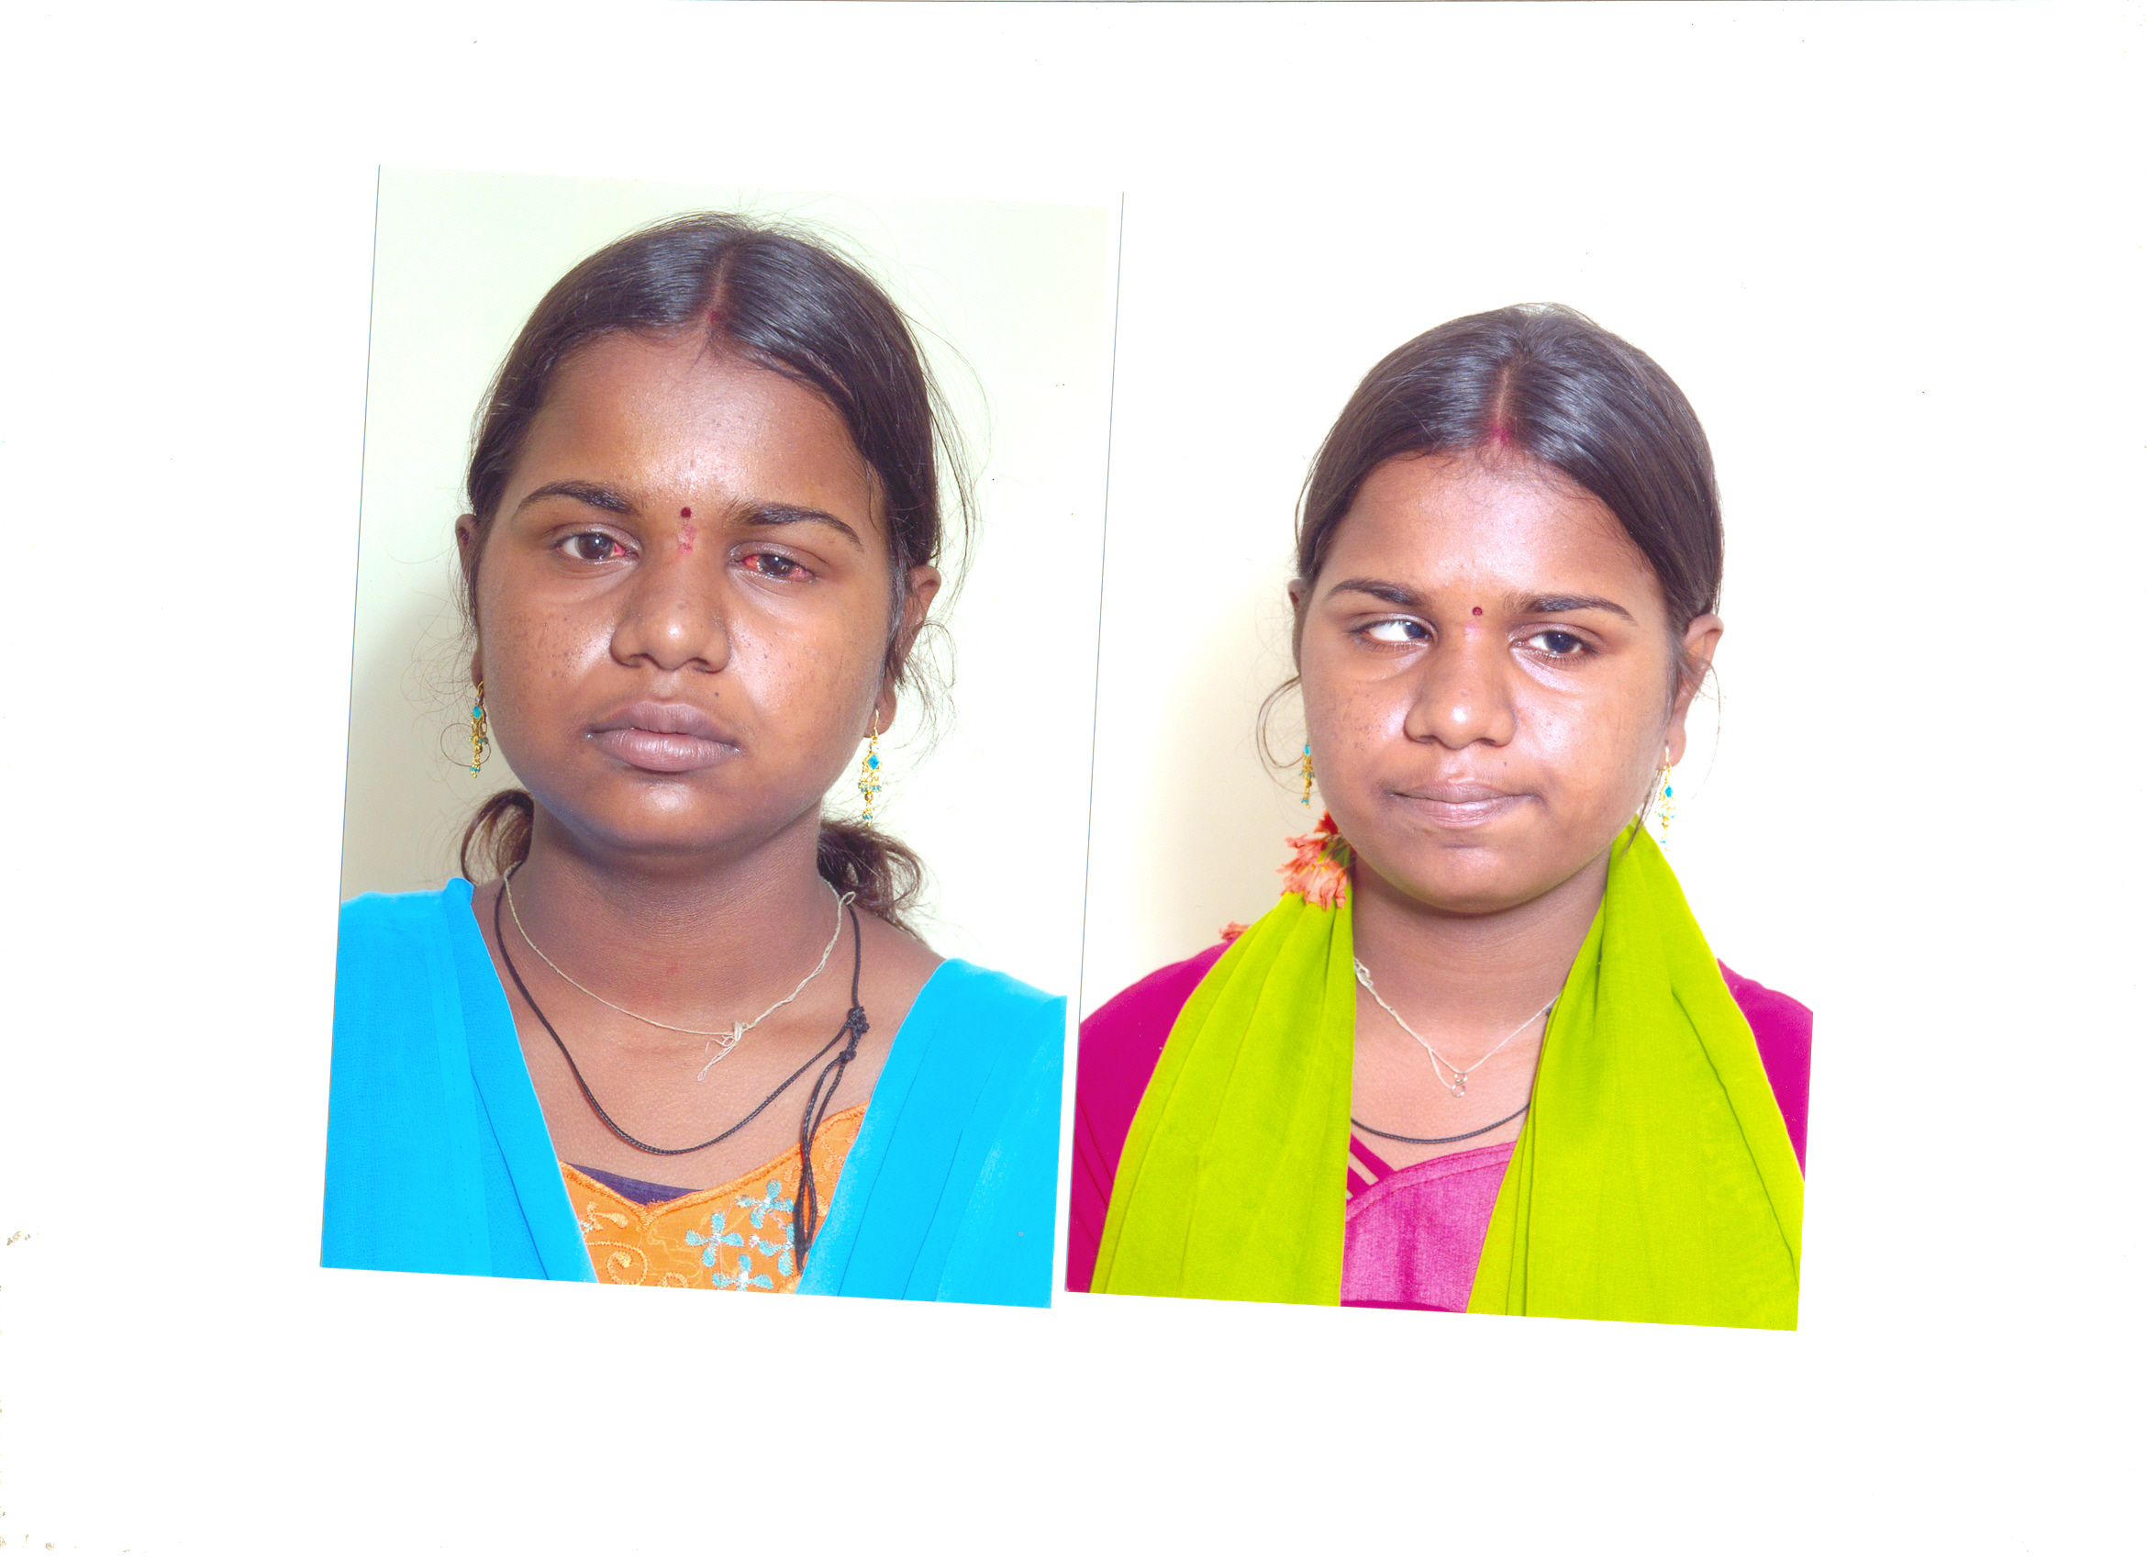
A young woman with crossed eyes received surgery that has allowed her to see and function as she should. As a result, she is now working in a clothing factory and will soon be given a small loan to start her own clothing business.

Slide 14
Corneal Transplant &
Eye Bank Unit
Angel C. Padilla Hospital
Tucuman, Argentina
RC of Tucuman, Argentina
More than 1 million people live in the northwestern region of Argentina. Before 2004 there were only two medical centers that were performing cornea transplants.
Notes:
More than 1 million people live in the northwestern region of Argentina. Before 2004 there were only two medical centers that were performing cornea transplants.

Slide 15
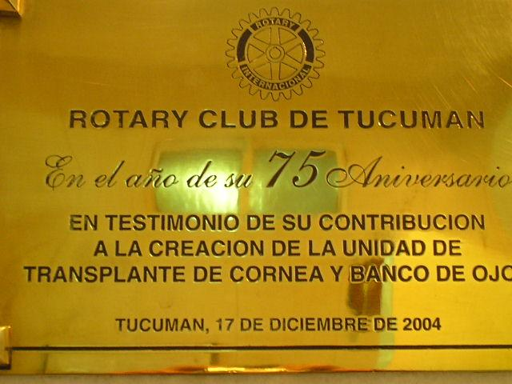
In 2004, thanks to the efforts of the Rotary Club of Tucuman, Argentina, a new eye bank was opened at the Angel C. Padilla Hospital.
Notes:
In 2004, thanks to the efforts of the Rotary Club of Tucuman, Argentina, a new eye bank was opened at the Angel C. Padilla Hospital.

Slide 16
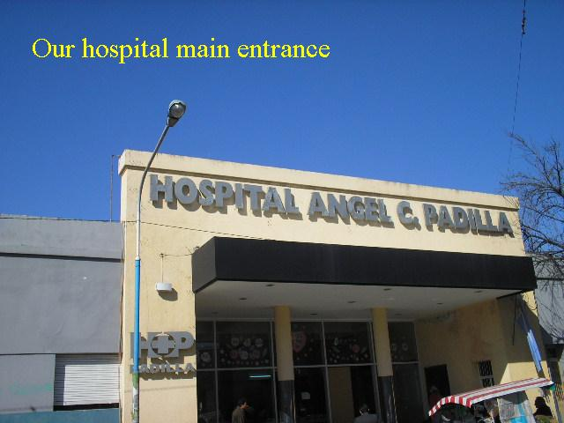
Since its opening in the fall of 2004 more than 5600 cornea transplants have been performed (an average of 26 transplants per month) and all have been at no cost to
low income recipients.
Notes:
Since its opening 54 cornea transplants have been performed and all have been at no charge to the low income recipients.

Slide 17
Shree Janaki Eye Hospital
Patient Bus
Janakpu, East Nepal
RI District 1990 (Switzerland)
RI District 1990 in Western Switzerland donated $145,000 (US$) to acquire essential instruments, equipment and a patient bus for the Nepal Red Cross’s Shree Janaki Eye Hospital.
Notes:
RI District 1990 in Western Switzerland donated $145,000 (US$) to acquire essential instruments, equipment and a patient bus for the Nepal Red Cross’s Shree Janaki Eye Hospital.

Slide 18
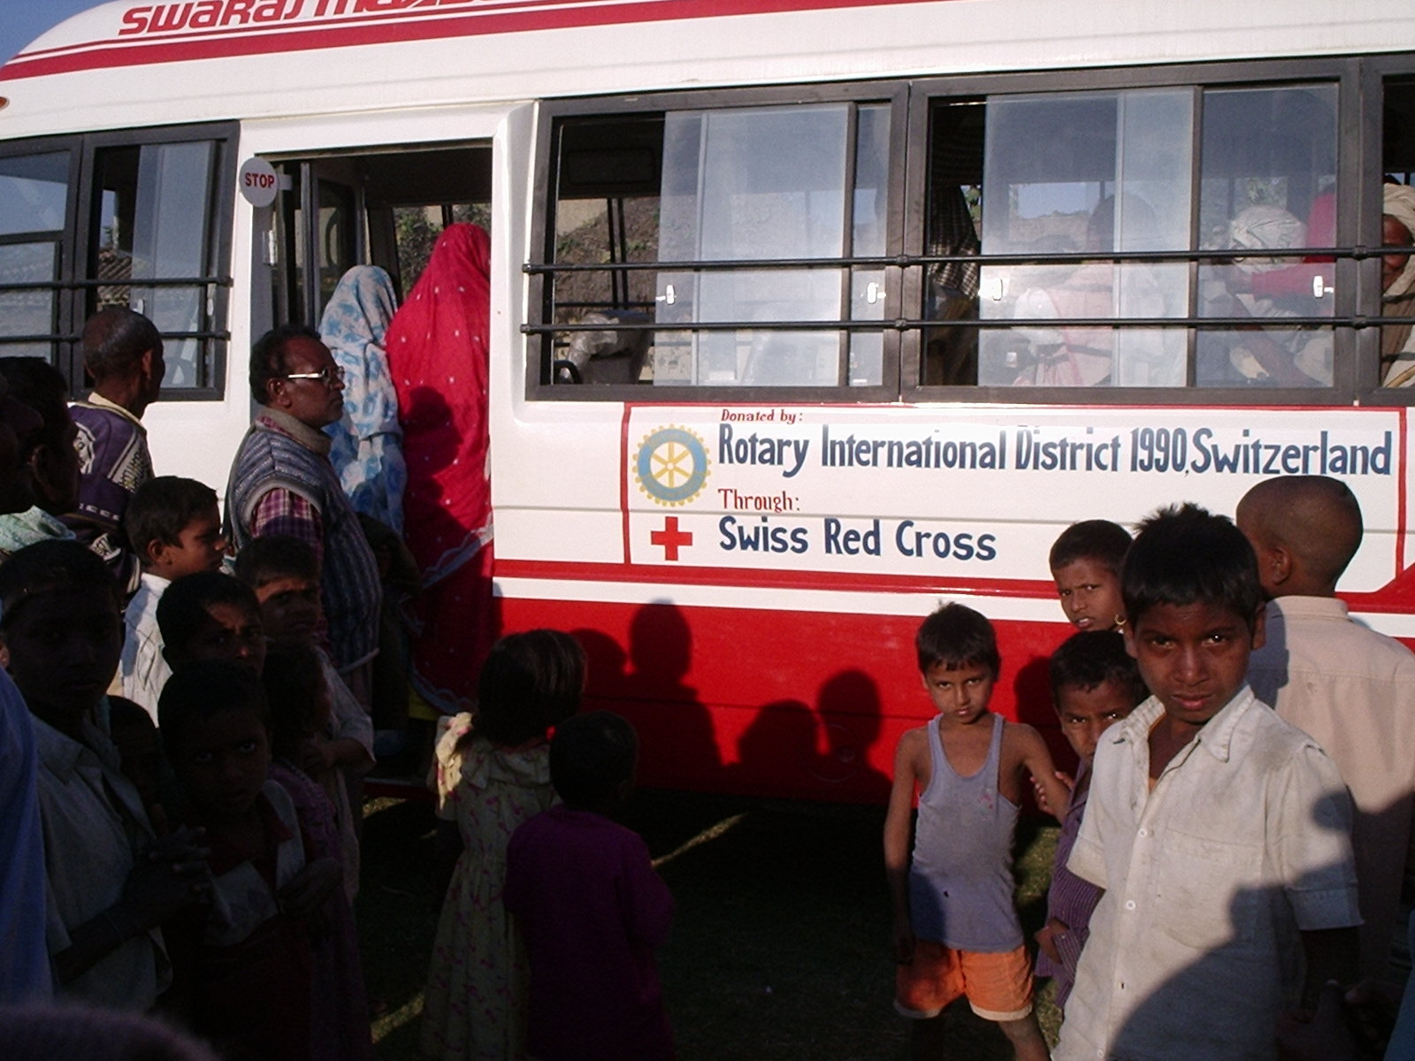
Each year this hospital restores the sight of over 6500 poor people by performing surgeries necessitated by poverty-induced cataract and trachoma. In addition, over 125,000 people receive clinical and educational services for which the bus has proven very important to reach remote populations. The RC of Jankpur assisted the hospital in the framing of the joint eye care programs of the Swiss Red Cross and the Nepal Red Cross.
Notes:
Each year this hospital restores the sight of over 6500 poor people by performing surgery necessitated by poverty-induced cataract and trachoma. In addition, over 125,000 people receive clinical and educational services for which the bus has proven very important to reach remote populations. The RC of Jankpur assisted the hospital in the framing of the joint eye care programs of the Swiss Red Cross and the Nepal Red Cross.

